Slide 1
Final Review
MATH 1550 - Precalculus

Slide 2
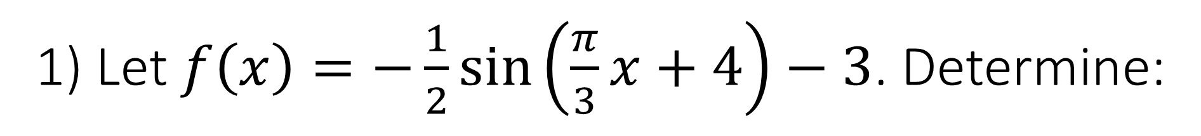
1) Let $f\left(x\right)=−\frac{1}{2}\sin\left(\frac{π}{3}x+4\right)−3$. Determine:
The amplitude;
The phase shift;
The vertical shift;
The period.

Slide 3
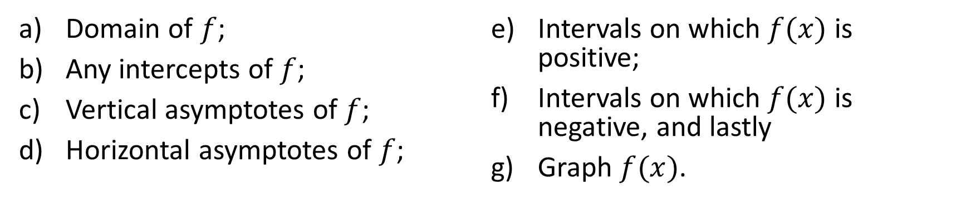
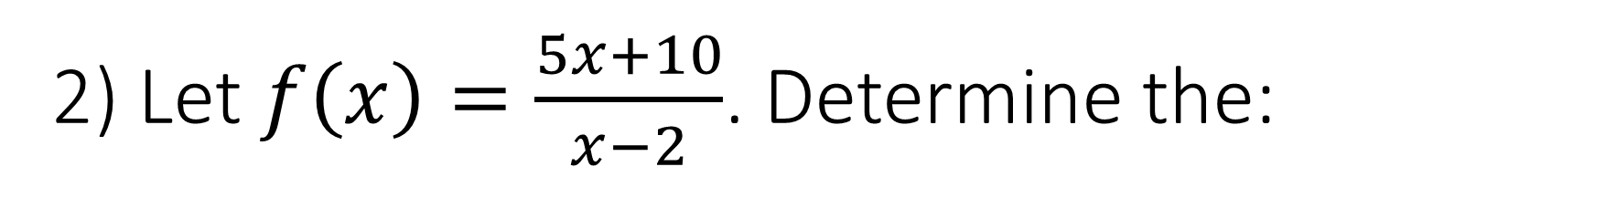
2) Let $f\left(x\right)=\frac{5x+10}{x−2}$. Determine the:
Domain of $f$;
Any intercepts of $f$;
Vertical asymptotes of $f$;
Horizontal asymptotes of $f$;
Intervals on which $f(x)$ is positive;
Intervals on which $f(x)$ is negative, and lastly
Graph $f(x)$.

Slide 4

3) Solve $\log_{2}\left(x+3\right)−\log_{2}\left(x−3\right)=4$.

Slide 5
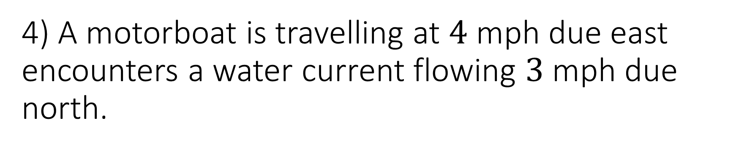
4) A motorboat is travelling at $4$ mph due east encounters a water current flowing $3$ mph due north.
Find the velocity of the boat relative to the current;
Find the heading angle the boat travels at relative to the water current.

Slide 6

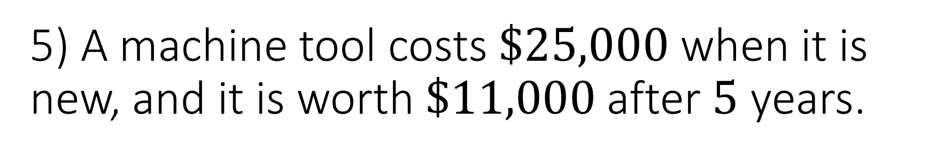
5) A machine tool costs $\$25,000$ when it is new, and it is worth $\$11,000$after $5$ years.
Assuming the depreciation is linear, find an equation that relates the value in dollars $V$ to the age in years $t$.
Use the equation to predict the value in $7$ years.

Slide 7

6) Let $9x2+36x−y2+10y+2=0$ be the equation of an ellipse.
Graph the ellipse.

Slide 8
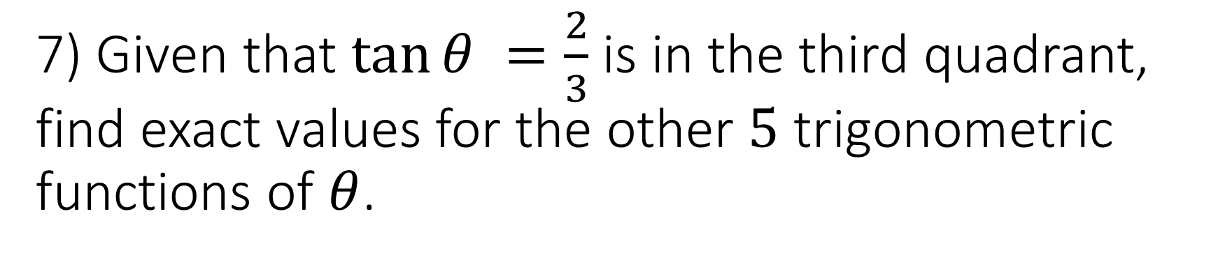
7) Given that $\tan{θ} =\frac{2}{3}$is in the third quadrant, find exact values for the other $5$ trigonometric functions of $θ$.

Slide 9
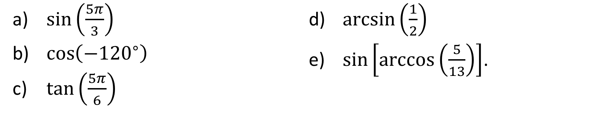
8) Give exact values for the following trigonometric expressions. Use radians if the answer is an angle.
$\sin\left(\frac{5π}{3}\right)$
$\cos\left(−{120}^{∘}\right)$
$\tan\left(\frac{5π}{6}\right)$
$\arcsin\left(\frac{1}{2}\right)$
$\sin\left[\arccos\left(\frac{5}{13}\right)\right]$.

Slide 10
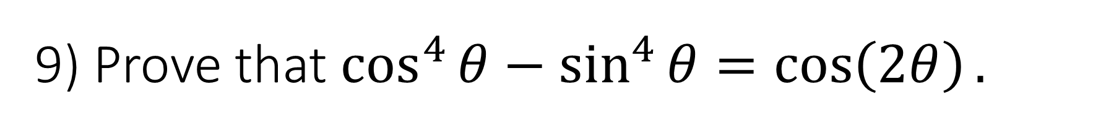
9) Prove that $\cos^{4}{θ}−\sin^{4}{θ}=\cos\left(2θ\right).$

Slide 11


a) Write the first five terms of the sequence ${\left\{6n+1\right\}}_{n=1}^{∞}$.
10)
b) Compute
$$\sum_{n=1}^{5}{\left(6n+1\right)}.$$

Slide 12
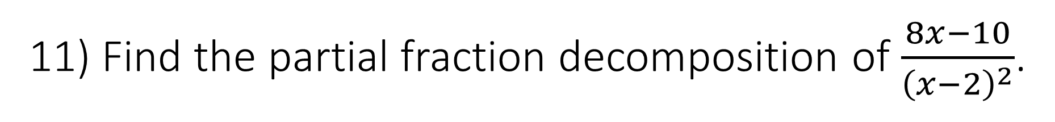
11) Find the partial fraction decomposition of $\frac{8x−10}{{\left(x−2\right)}^{2}}$.

Slide 13
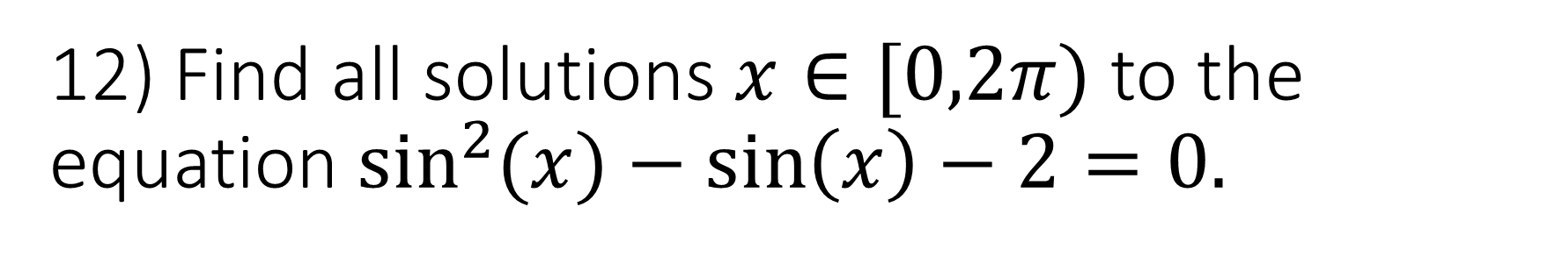
12) Find all solutions $x∈[0,2π)$ to the equation $\sin^{2}{(x)}−\sin\left(x\right)−2=0.$

Slide 14
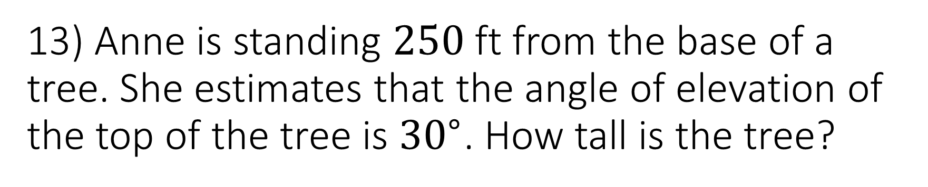
13) Anne is standing $250$ ft from the base of a tree. She estimates that the angle of elevation of the top of the tree is ${30}^{∘}$. How tall is the tree?

Slide 15
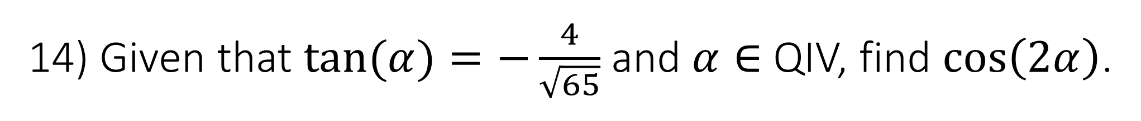
14) Given that $\tan{(α)}=−\frac{4}{\sqrt{65}}$ and $α∈$ QIV, find $\cos\left(2α\right)$.

Slide 16
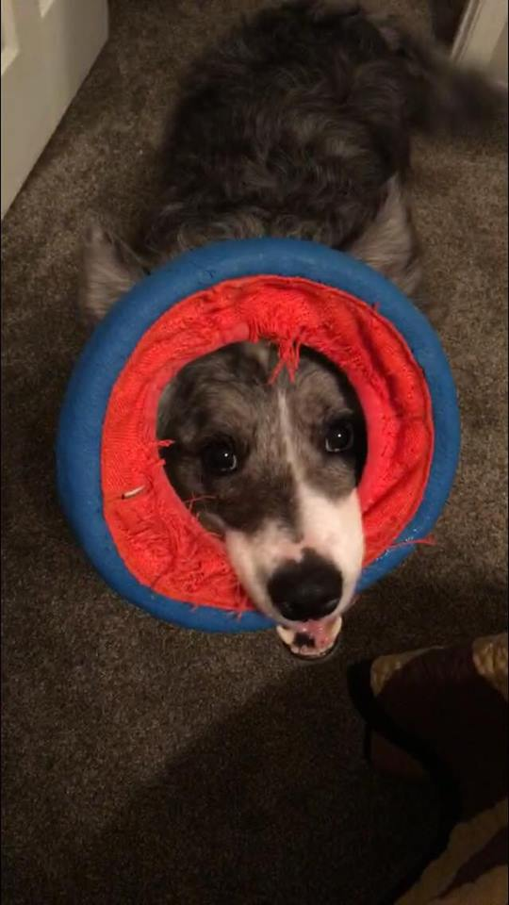
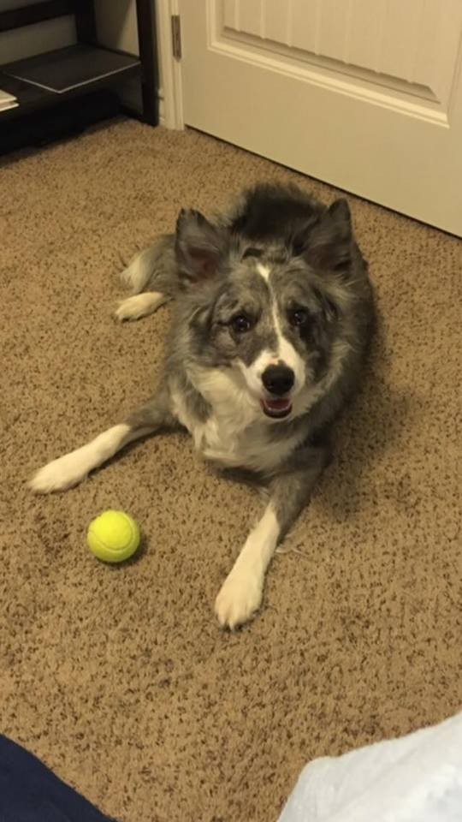
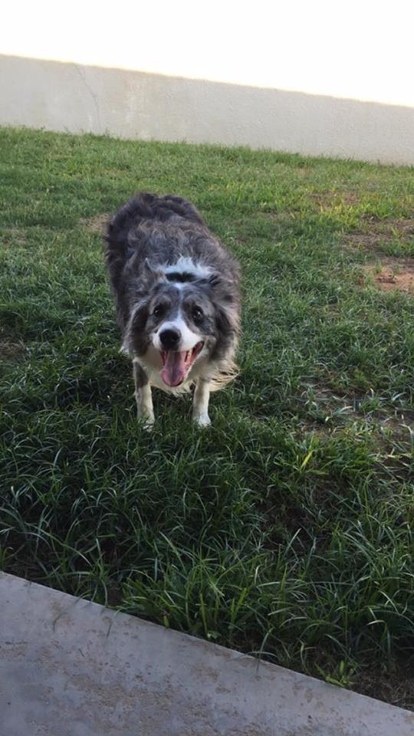
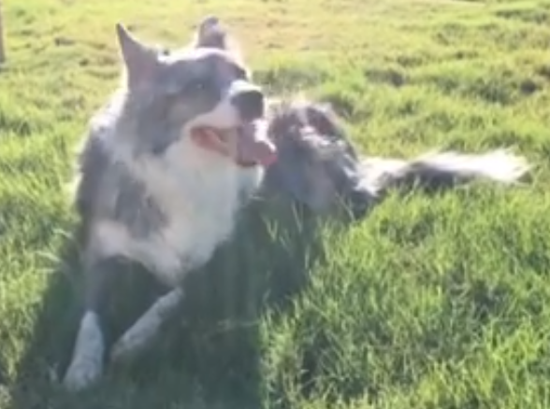
Thanks so much for your cooperation this semester!

